Slide 1
Lecture 2
Finite Sample Space
The Probability of a Union of Events

Slide 2

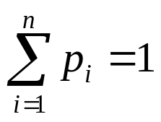
1.6 Finite Sample Space
The sample space S contains only a finite number of points (outcomes) s1, ..., sn.
A probability distribution on S is specified
by assigning a probability pi to each point si.
  For i=1, ..., n,
  Also,
  The probability of any event A can be found by adding
  the probabilities pi of all outcomes si that belong to A.

Slide 3
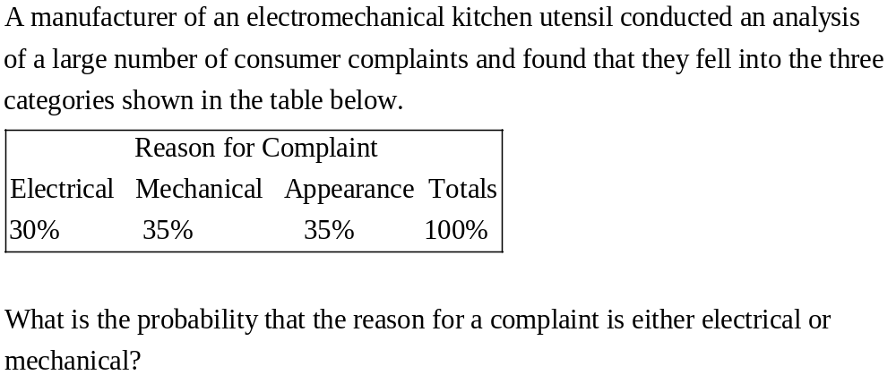
Example: Consumer Complaints

Slide 4
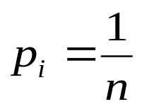
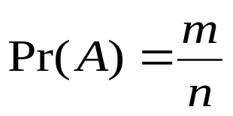
Simple Sample Spaces
A sample space S containing n outcomes s1, ..., sn is called a simple sample space if ,
i=1, ..., n.
If an event A contains exactly m outcomes, then

Slide 5
Example: Coke vs Pepsi?
Suppose that in some population, the probability of preferring coke over Pepsi is 50%. Three people are surveyed. What is the probability that exactly two people perfer Coke?
  The sample space contains 8 outcomes.
  S1: CCC
  S2: PCC
  S3: CPC
  S4: CCP
  S5: CPP
  S6: PCP
  S7: PPC
  S8: PPP
Simple sample space!
A contains 3 outcomes, so
Pr(A)=3/8

Slide 6
1.8 Permutation and Combination
In a simple sample space S, the probability of an event A is the ratio of the number of outcomes in A to the total number of outcomes in S.
How to determine the number of total outcomes in the space S and in various events in S without compling a list of the outcomes?

Slide 7
Permutation
Consider the experiment:
  A card is selected and removed from a deck of n different cards.
#S=n
  A second card is selected and removed from the
  remaining n-1 cards.
#S=n(n-1)
  A third card is selected and removed from the
  remaining n-2 cards.
#S=n(n-1)(n-2)
  ....
  A kth card is selected and removed from the
  remaining n-k+1 cards.
#S=n(n-1)...(n-k+1)

Slide 8
Each different arrangement is called a permutation.
Note: (a,b) and (b,a) are different permutations.
Pn,k=n(n-1)...(n-k+1) is called the number of permutations of n elements taken k at a time.

Slide 9
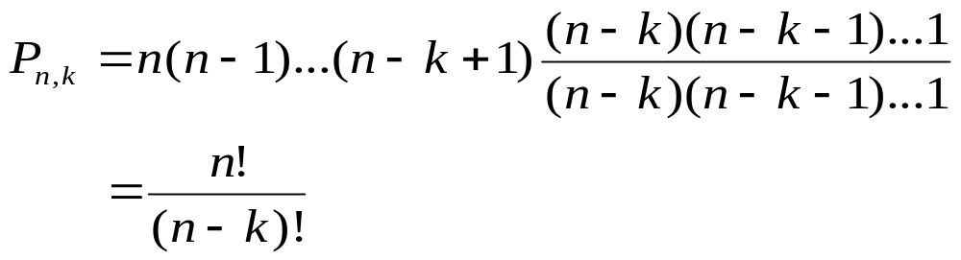
When k=n, the experiment result in different permutations of all n cards:
Pn,n=n(n-1)...1=n! (n factorial)
Alternately, we can write
Define 0!=1, then the relation Pn,k=n!/(n-k)!
is correct for k=n as well as k=1,...,n-1.

Slide 10
Example 1.7.1 Choosing Officers
A president and a secretary are to be chosen from 25 members. What is the total number of ways in which these two positions can be filled?
P25,2=(25)(24)=600

Slide 11

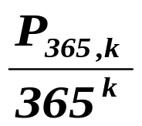
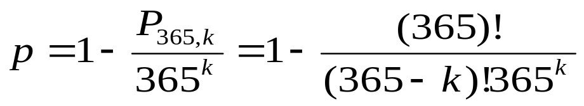
The Birthday Problem
What is the probability that at least two people in a group of k people ( )
will have the same birthday?
  Assume the birthdays of the k people are unrelated.
  Also assume that each of the 365 days is equally
  likely to be the birthday of any person in the group.
  The probability that all k people will have different
  birthday is
  The probability that at least two people will have
  the same birthday is
Notes:
The assumption may not correct. For example, it might happen that more people are given birth in the summer.

Slide 12
k=10, p=0.1169482
k=20, p=0.4114384
k=30, p=0.7063162
k=40, p=0.8912318
k=50, p= 0.9703736

Slide 13
Combination
  A subset of k elements is to be selected from a set of n distinct elements.
  The arrangement of the elements in a subset is irrelevant.
  Each subset is called a combination.
  The subsets {a,b} and {b,a} are identical.
  Let Cn,k denote the number of combinations of n elements taken k at a time.

Slide 14
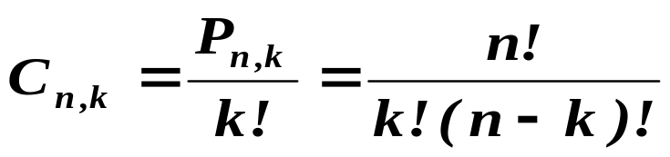
How to calculate Cn,k?
  We can construct a list of all Pn,k permutations with k elmements out of n elements as follows:
    First, a particular combination of k elments is selected.
    These k elements can be permutated in k! ways.
  The number of permutations can be calculated by
  k!Cn,k
  So

Slide 15
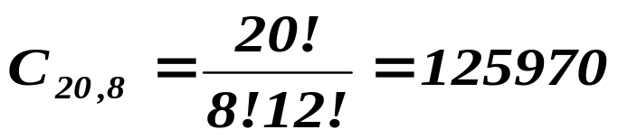
Example 1.8.1 Selecting A Committee
A committee of 8 people is to be selected from a group of 20 people. The number of different ways of selecting the committee is

Slide 16

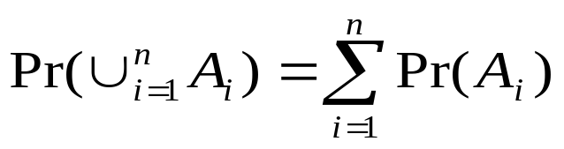
1.10 The Probability of A Union of Events
The sample space S may contain either a finite number of outcomes or an infinite number. We will study the probability of the union of n events A1,...,An.
  If the events are disjoint,

Slide 17
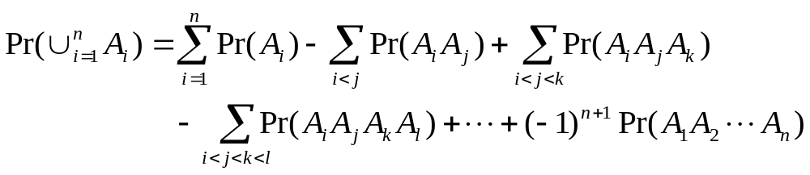
Theorem. For any n events A1, ..., An,
Notes:
The theorem is given. We do not need to figure out how it comes to be. But we can get some intuition about that.

Slide 18

The Collector’s Problem
Suppose that each package of bubble gum contains the picture of a basketball player; that the pictures of r different players are used; that the picture of each player is equally likely to be placed in any given package of gum; and that pictures are placed in different packages independently of each other. What is the probability p that a person who buys n packages of gum ( ) will obtain a complete set of r different pictures.

Slide 19

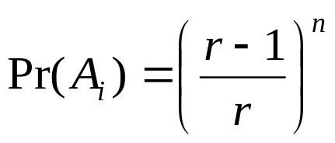
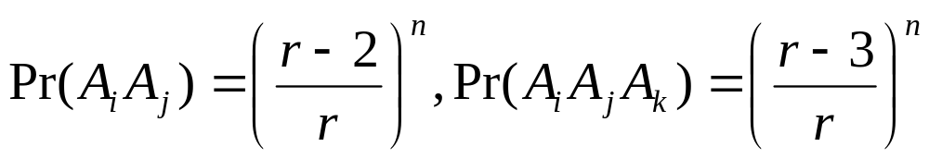
  The complementary event is that the picture of at least one player is missing.
  Let Ai denote the event that the picture of player I is missing from all n packages. Then,
  The probability that the picture of player i will not be obtained in any particular package is (r-1)/r, so
  Similarly,

Slide 20
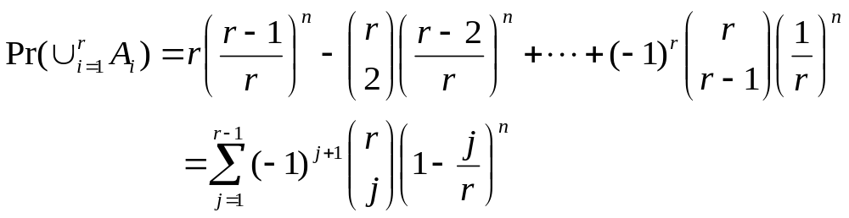
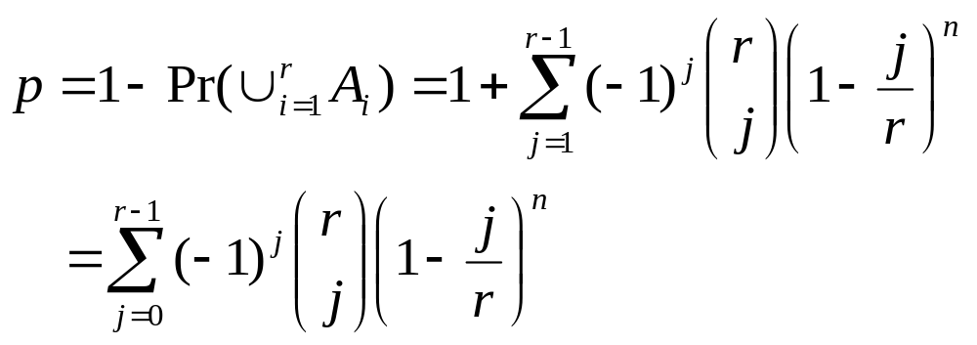
  According to the probability of a union of events,
  Thus,

